Slide 1
BICB 8510 Computation Biology
Deep Learning in Medical Imaging Processing
Quincy G., Predoctoral
Bioinformatics and Computational Biology Graduate Program
University of Minnesota

Slide 2
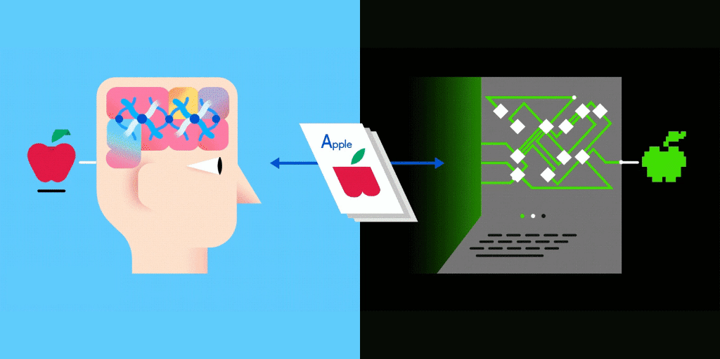
Learning Objective
1. Quick Review of Machine Learning
2. General Introduction to Deep Learning
3. Mathematics in AI
2.1.1. Forward- & Backward- propagation
2.1.2. Activation Functions in Deep Neural Networks
1.1.1. Supervised & Unsupervised Learning
1.1.2. Reinforcement Learning
1.1.3. Classification & Clustering Problem
3.1.1. General Intro of math & AI
3.1.2. Convolution in Mathematics
3.1.3. Convolutional Neural Network (CNN)

Slide 3

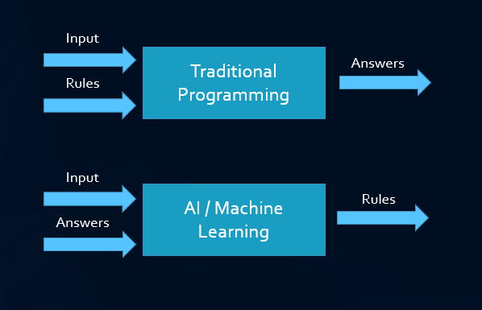
Machine Learning V.S. Traditional Programming
Traditional Programming
Machine Learning
Richard Bellairs, 2018.
Nektarios Kalogridis, 2019.

Slide 4
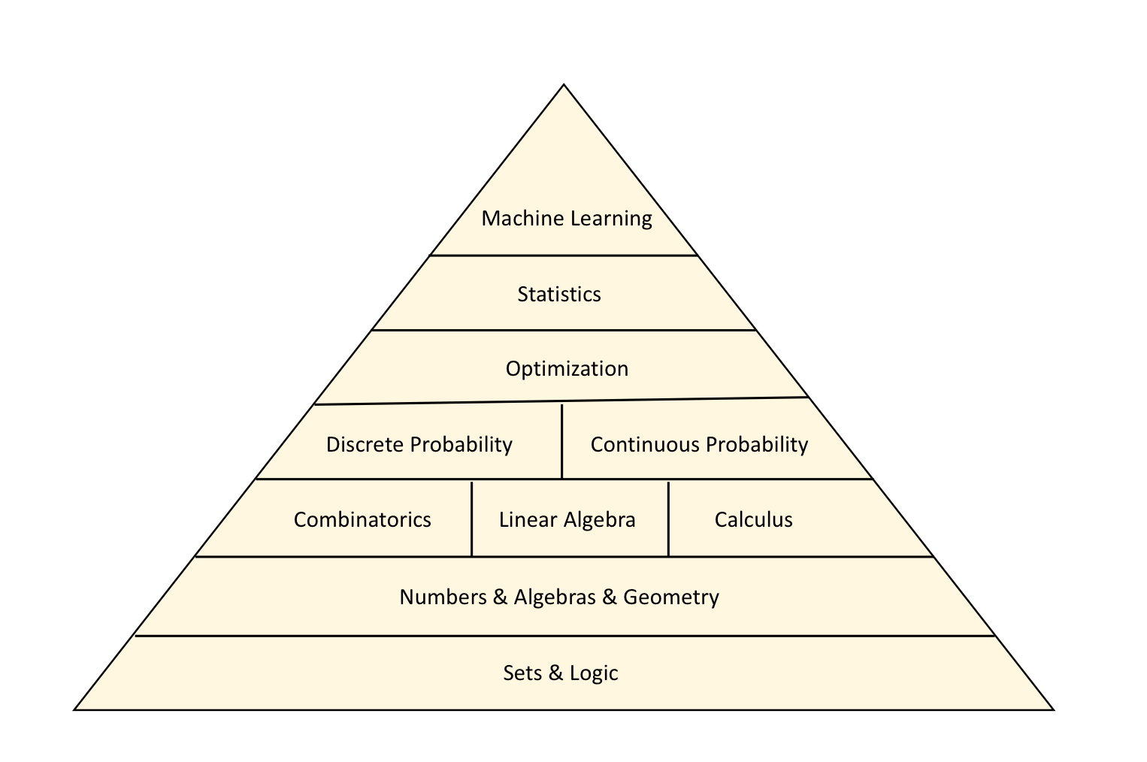
Mathematics in Machine/Deep Learning
Garrett Jenkinson, Gavin Oliver, Mayo Clinic CIM, 2021

Slide 5
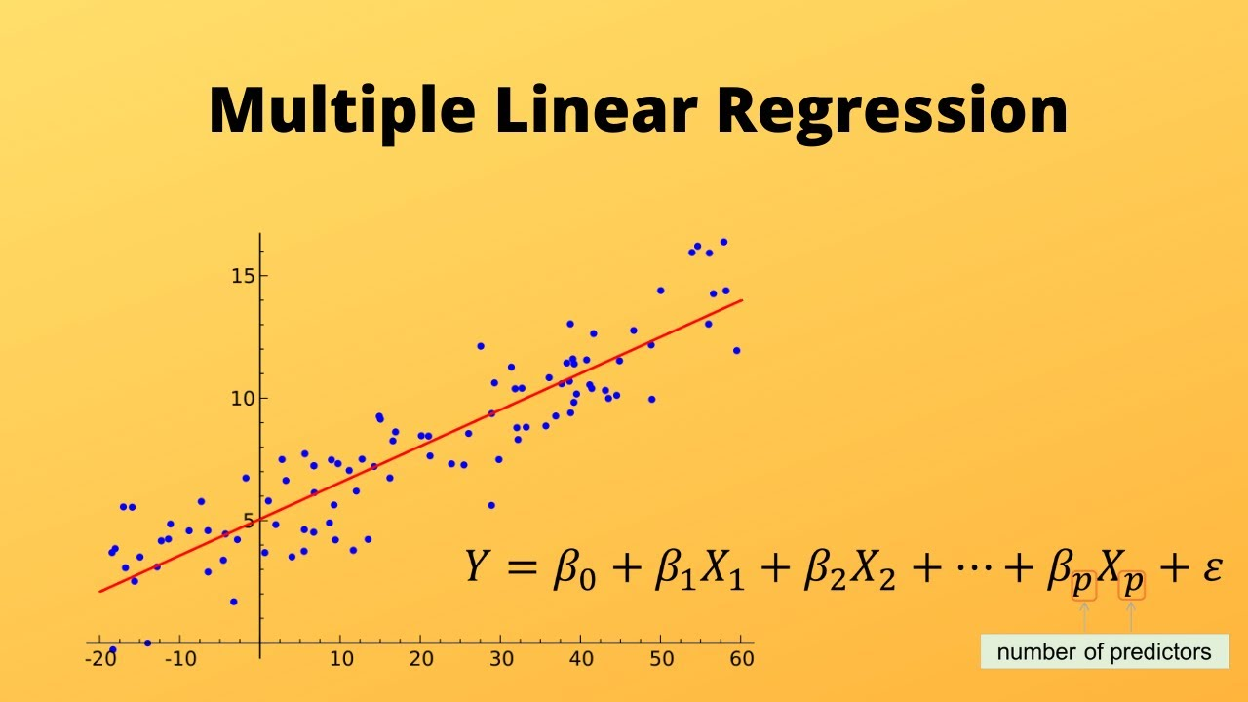
ML - Learn by the given factors
Machine Learning engineer needs to define the potential impact factors for model to learn
Model needs to figure out what could affect the final predictions
Classical Machine Learning Example - Linear Regression on house price prediction
Felix Kling, 2020

Slide 6
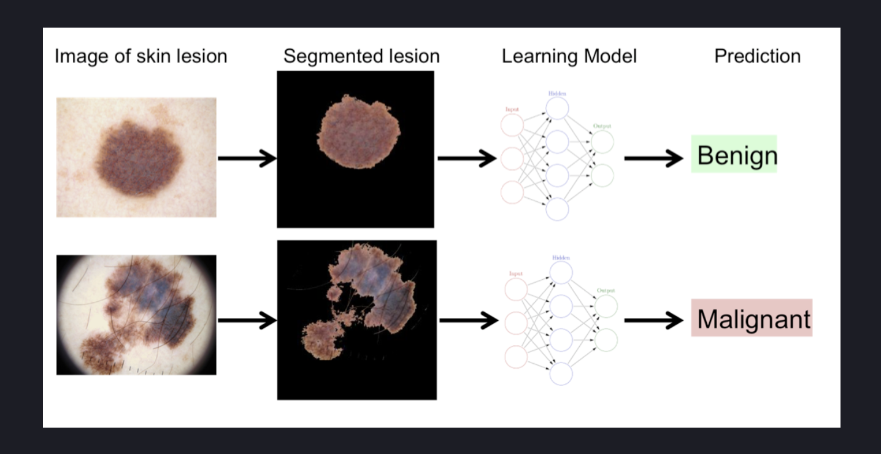
DL - Find Pattern itself
Deep Learning engineers only define the objective of the problem that needs the deep neural networks to solve
No patterns or potential impact factors will be provided by the model
Deep Learning models learn the patterns by themselves
Deep Learning - Black Box
Future of Deep Learning - Causality or Interpretable Deep Neural Networks, etc.
Andrew, Ng.

Slide 7
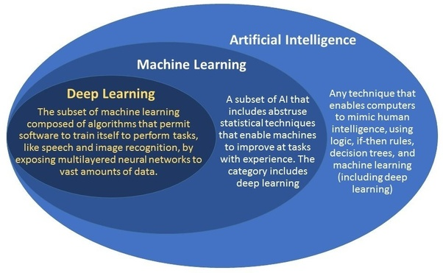
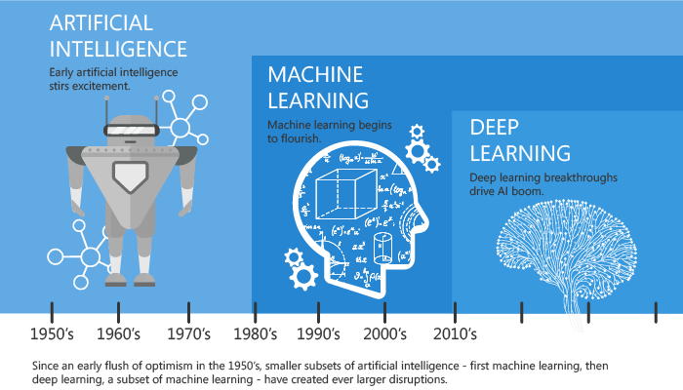
Machine Learning V.S. Deep Learning
Vikas Kumar Sharma, 2018

Slide 8
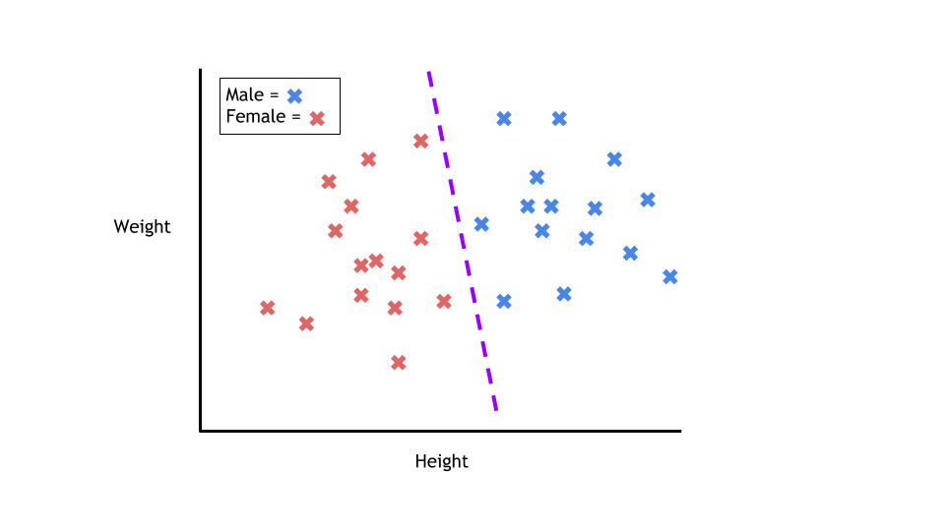
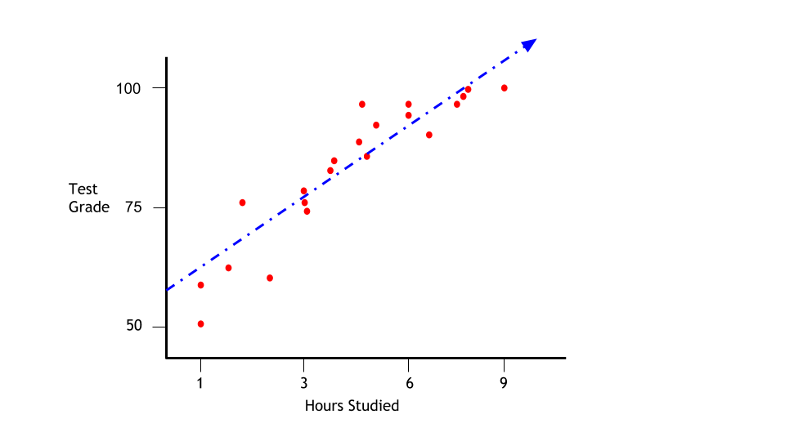
Supervised Learning
Discriminative Model / Generative Model
Classification - Learn Decision Boundary (Estimate 𝘗(𝑦|𝓍))
Regression - Learn Probability Distribution of Data (1st Estimate 𝘗(𝓍|𝑦) → 𝘗(𝑦|𝓍))
𝑌^=𝑓(𝓍) - Predicted Output Value based on Input Data 𝓍, 𝑌 - Ground Truth Output Value
Aidan Wilson, 2019

Slide 9
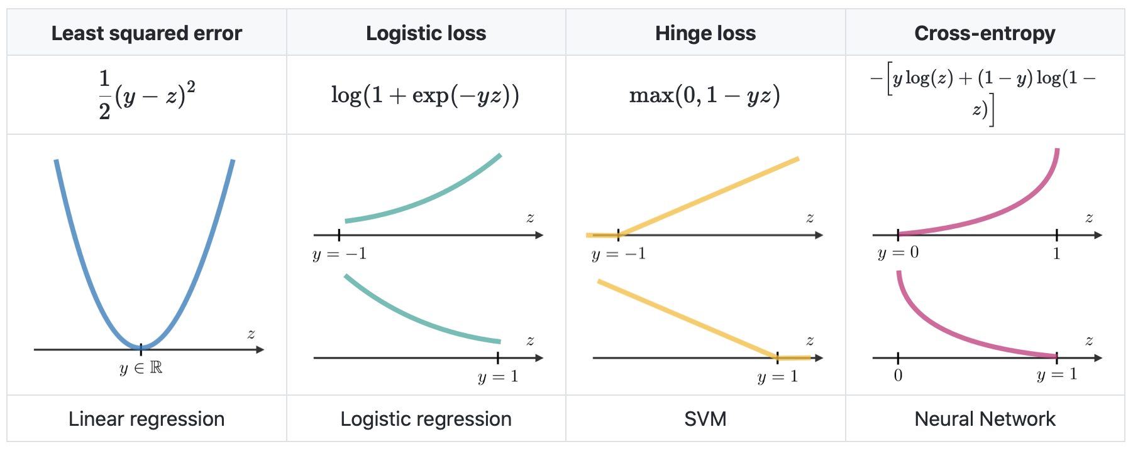
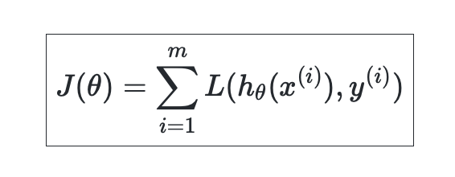
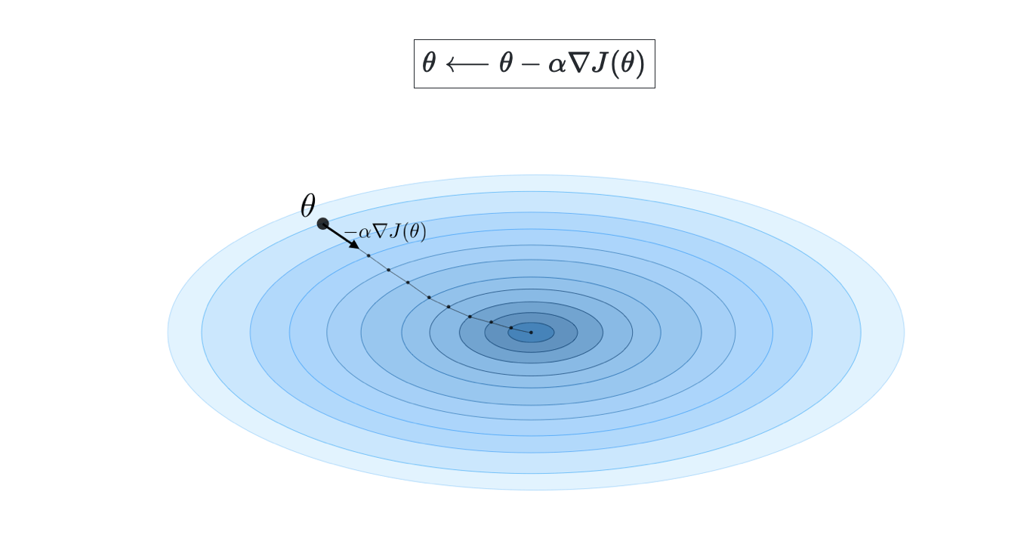
Supervised Learning Assessment
Loss Function
Cost Function
Gradient Descent with Cost Function
Afshine Amidi, Shervine Amidi

Slide 10
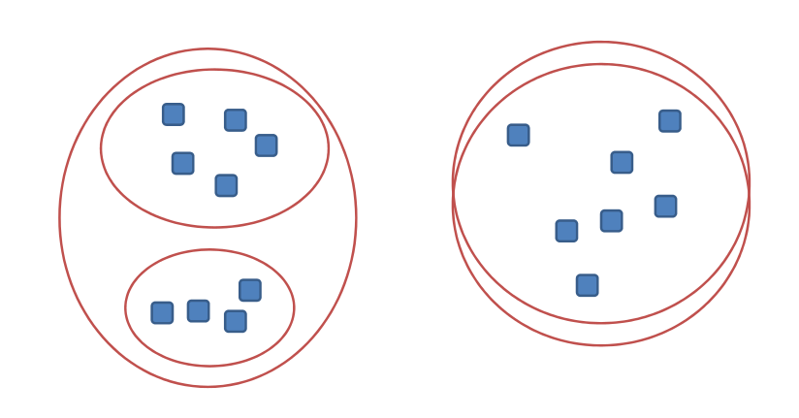
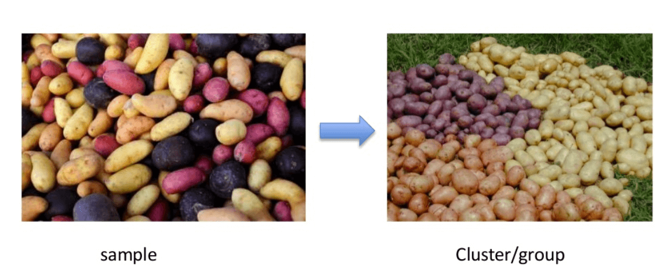
Unsupervised Learning
Distance-based clustering task - find the patterns of unlabeled data points 𝓍
Maximize distances between samples are different
Minimize distances between samples are similar
Distance computation Options:
Euclidean Distance
Manhattan Distance
Chebyshev Distance
Mahalanobis Distance
Sanatan Mishra, 2017; Guru99

Slide 11
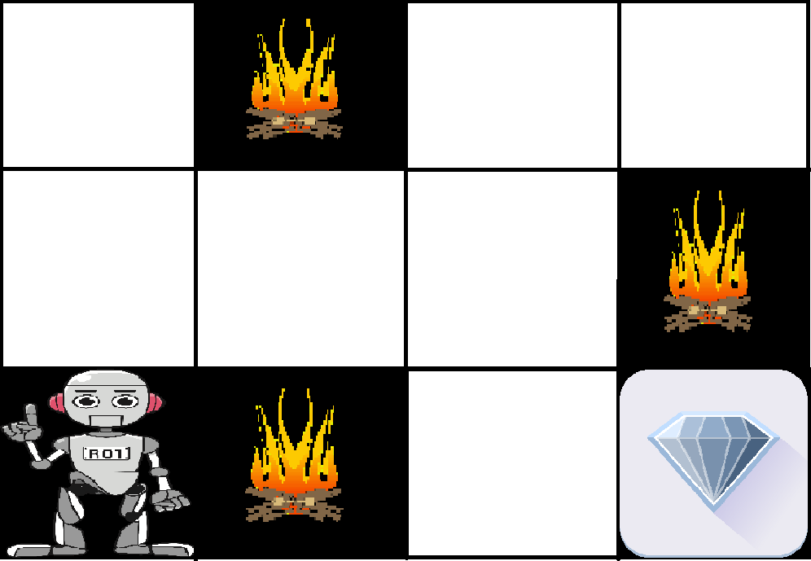

Reinforcement Learning
Ȿ - set of states
Ą - set of actions
{𝙋_{şа}} - state transition probabilities for ş∈Ȿ & а∈Ą
𝛾∈[0,1] - discount factor
Ɽ:ⱾxĄ → ℝ / Ɽ:Ȿ →Ą reward function needs to be maximized
π:Ȿ →Ą - policy function
Value Function (in below) - determine the performance of actions in the future

Slide 12
Deep Learning - 2 Propagations
Forward propagation
Given input to get the output of the prediction results by the model
Simple math - return the value of dependent variable y by given the input independent variable x
Example - y = w * x + b
Weights - w
Bias - b
Backward propagation
Improve the prediction results
Find the best weights and bias values to get the expected value of the dependent variable y with the given independent variable x
Simple math - Differentiation/Derivative
Optimization process to update the values of a and b with the example in forward propagation

Slide 13
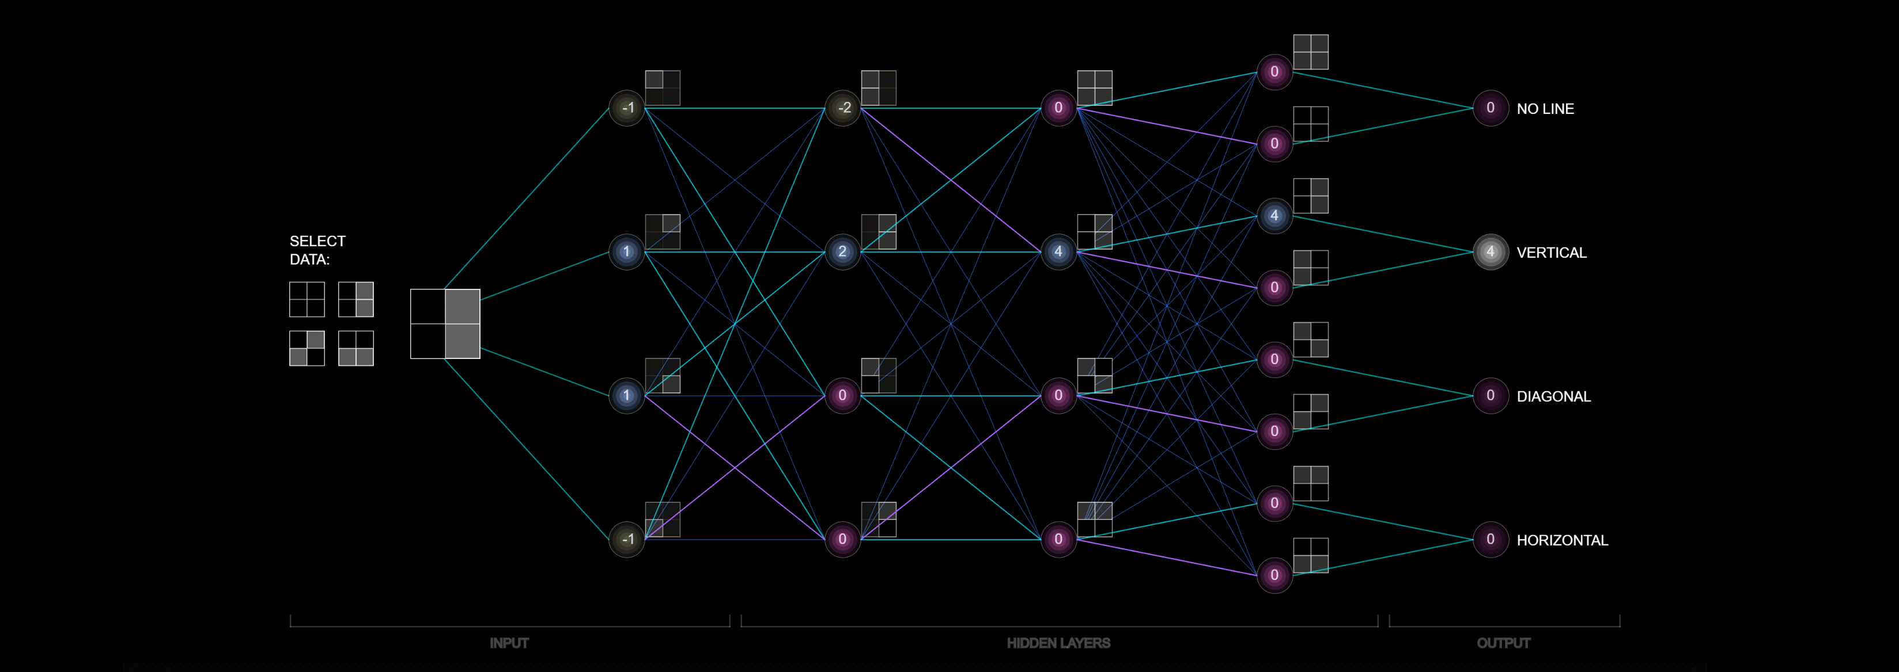
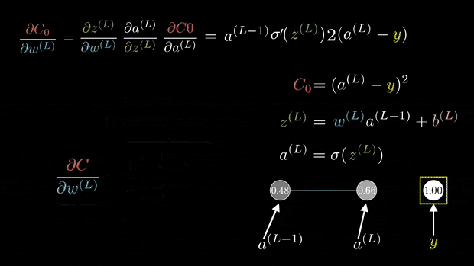
Forward- & Backward- Propagation
Cite: Monica Zhou and Gfycat

Slide 14
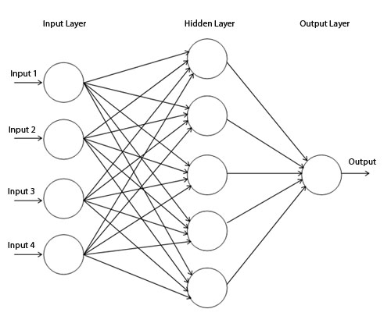
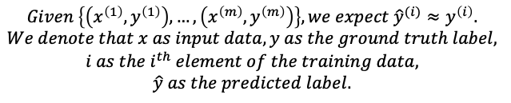
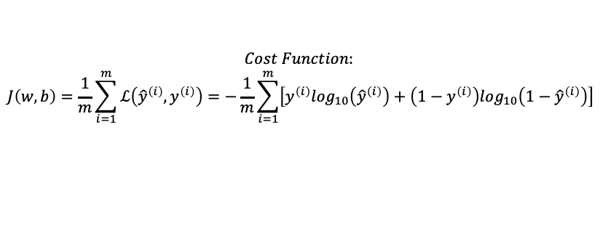
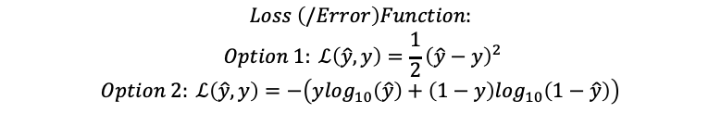
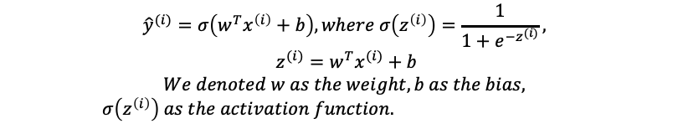
Activation Functions in Deep Neural Networks
$$Given \left\{\left(x^{\left(1\right)},y^{\left(1\right)}\right), …, \left(x^{\left(m\right)},y^{\left(m\right)}\right)\right\}, we expect {\hat{y}}^{(i)}≈y^{\left(i\right)}.$$
$$We denote that x as input data, y as the ground truth label,$$
$$i as the i^{th} element of the training data,$$
$$\hat{y} as the predicted label.$$
$${\hat{y}}^{(i)}=σ\left(w^{T}x^{\left(i\right)}+b\right), where σ\left(z^{\left(i\right)}\right)=\frac{1}{1+e^{{−z}^{(i)}}},$$
$$z^{(i)}=w^{T}x^{(i)}+b$$
$$We denoted w as the weight, b as the bias,$$
$σ\left(z^{\left(i\right)}\right) as the activation function.$
$$Loss \left(/Error\right)Function:$$
$$Option 1: ℒ\left(\hat{y},y\right)=\frac{1}{2}{\left(\hat{y}−y\right)}^{2}$$
$$Option 2: ℒ\left(\hat{y},y\right)=−\left(y\log_{10}\left(\hat{y}\right)+\left(1−y\right)\log_{10}\left(1−\hat{y}\right)\right)$$
$$Cost Function:$$
$$J\left(w, b\right)=\frac{1}{m}\sum_{i=1}^{m}{ℒ\left({\hat{y}}^{\left(i\right)},y^{\left(i\right)}\right)=−\frac{1}{m}\sum_{i=1}^{m}{\left[y^{\left(i\right)}\log_{10}\left({\hat{y}}^{\left(i\right)}\right)+\left(1−y^{\left(i\right)}\right)\log_{10}\left(1−{\hat{y}}^{\left(i\right)}\right)\right]}}$$

Slide 15
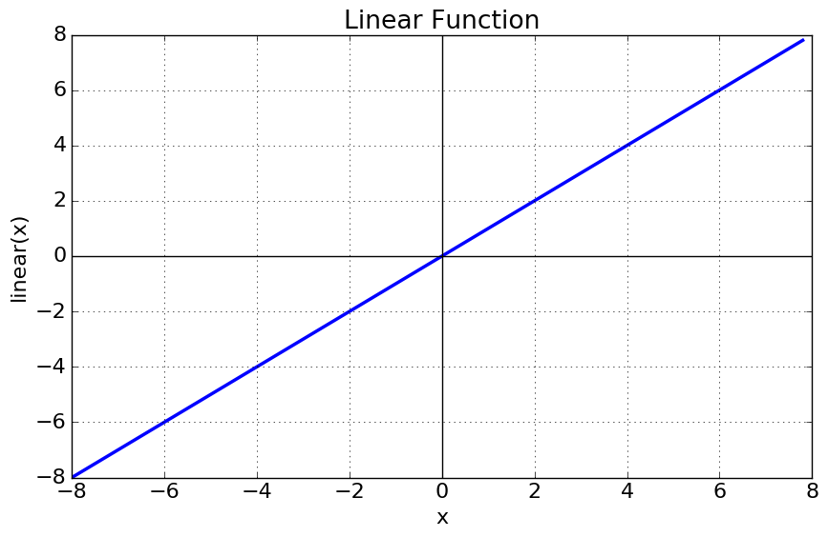
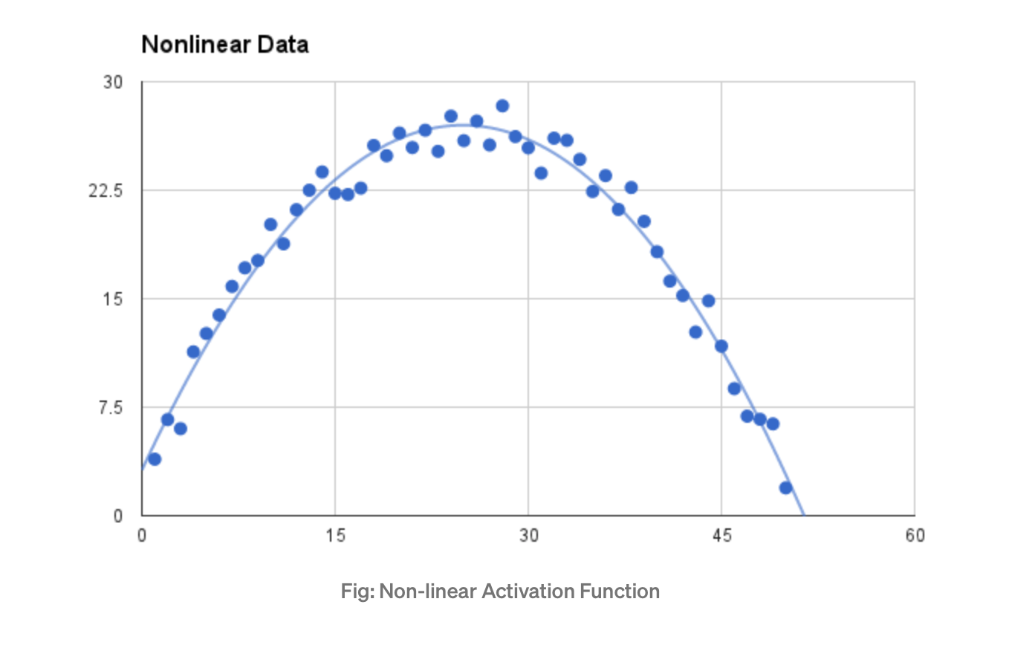
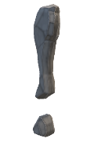
Activation Functions in Deep Neural Networks
Activation Functions should be differentiable
Cite: Sagar Sharma, Sep 6th, 2017.

Slide 16
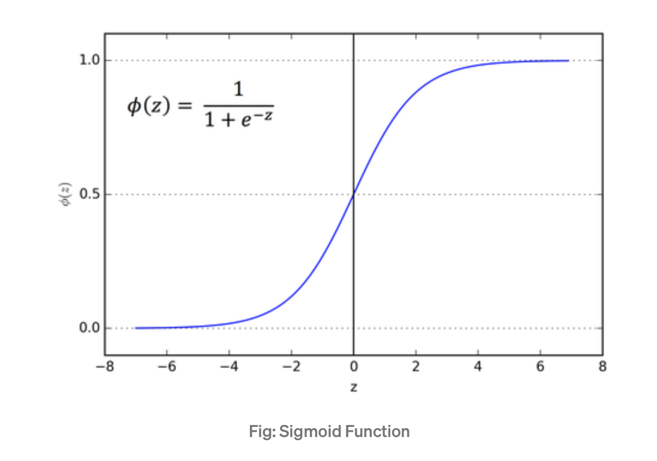
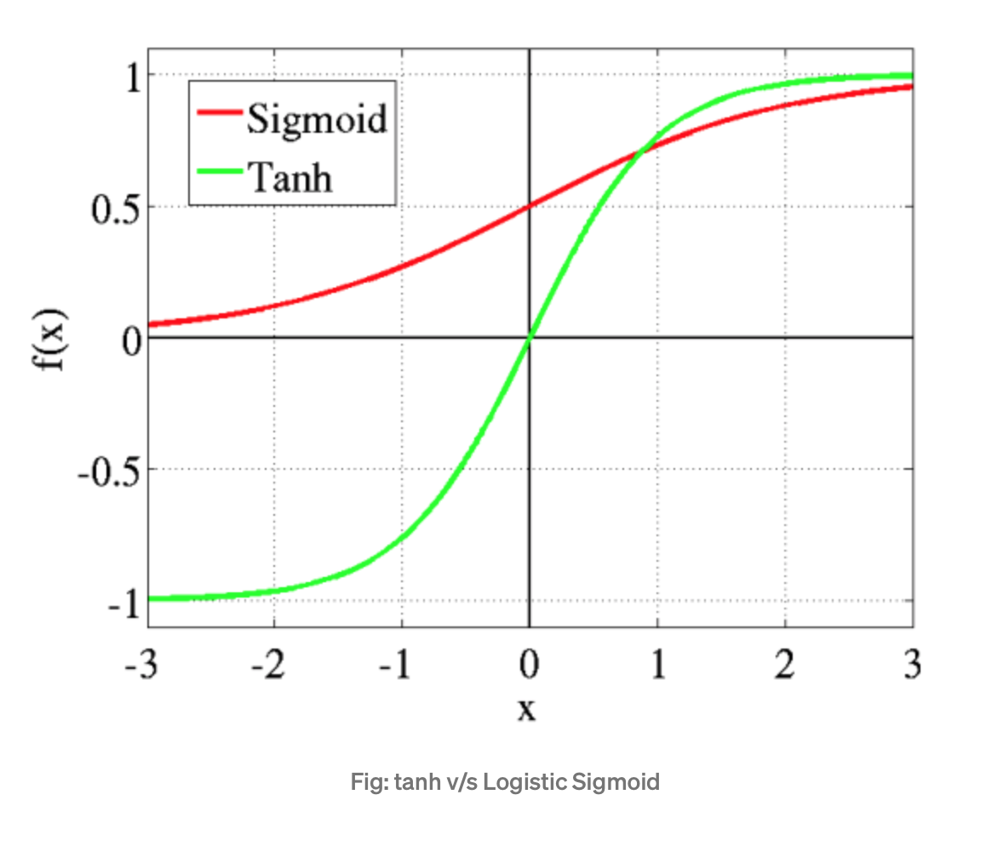
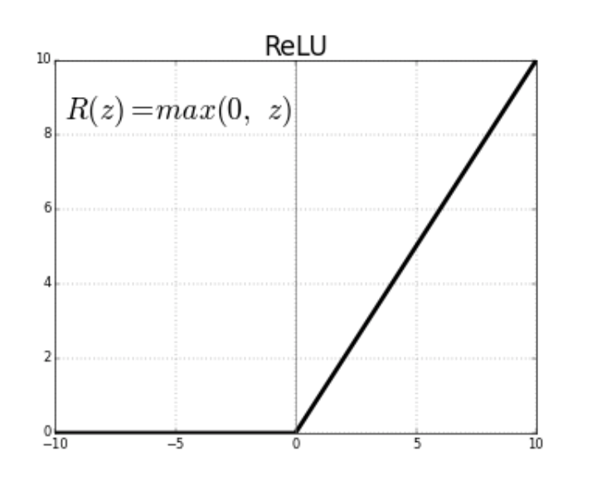
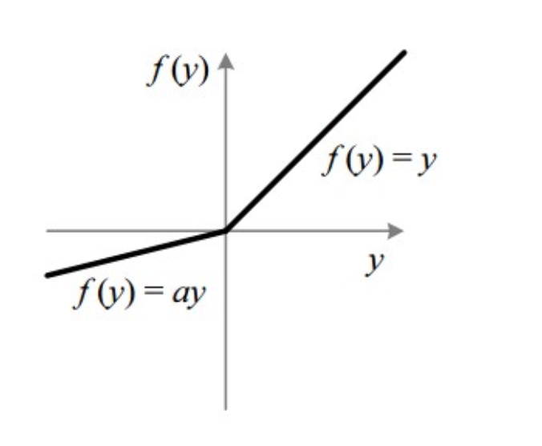
Non-Linear Activation Functions
Sigmoid / Logistic Activation Function
Tanh / Hyperbolic Tangent Activation Function
ReLU (Rectified Linear Unit) Activation Function
Leaky ReLU
Cite: Sagar Sharma, Sep 6th, 2017.

Slide 17

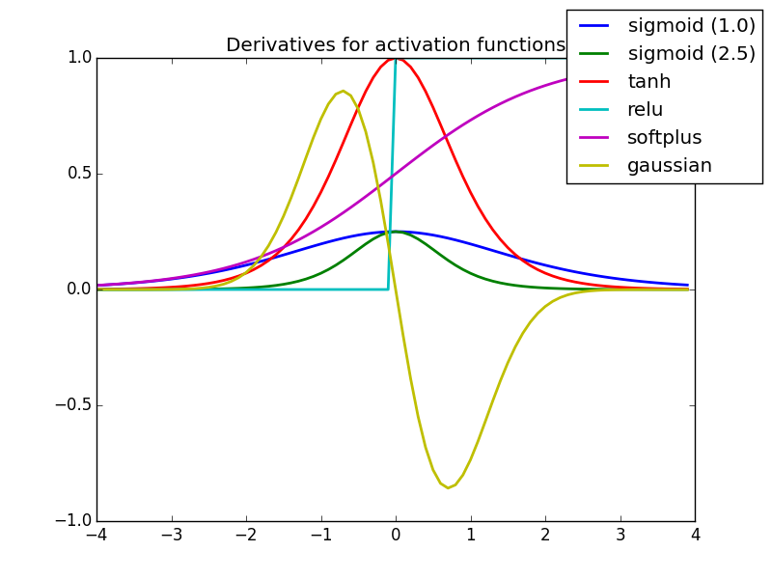
More about Activation Functions
Cite: Sagar Sharma, Sep 6th, 2017.

Slide 18
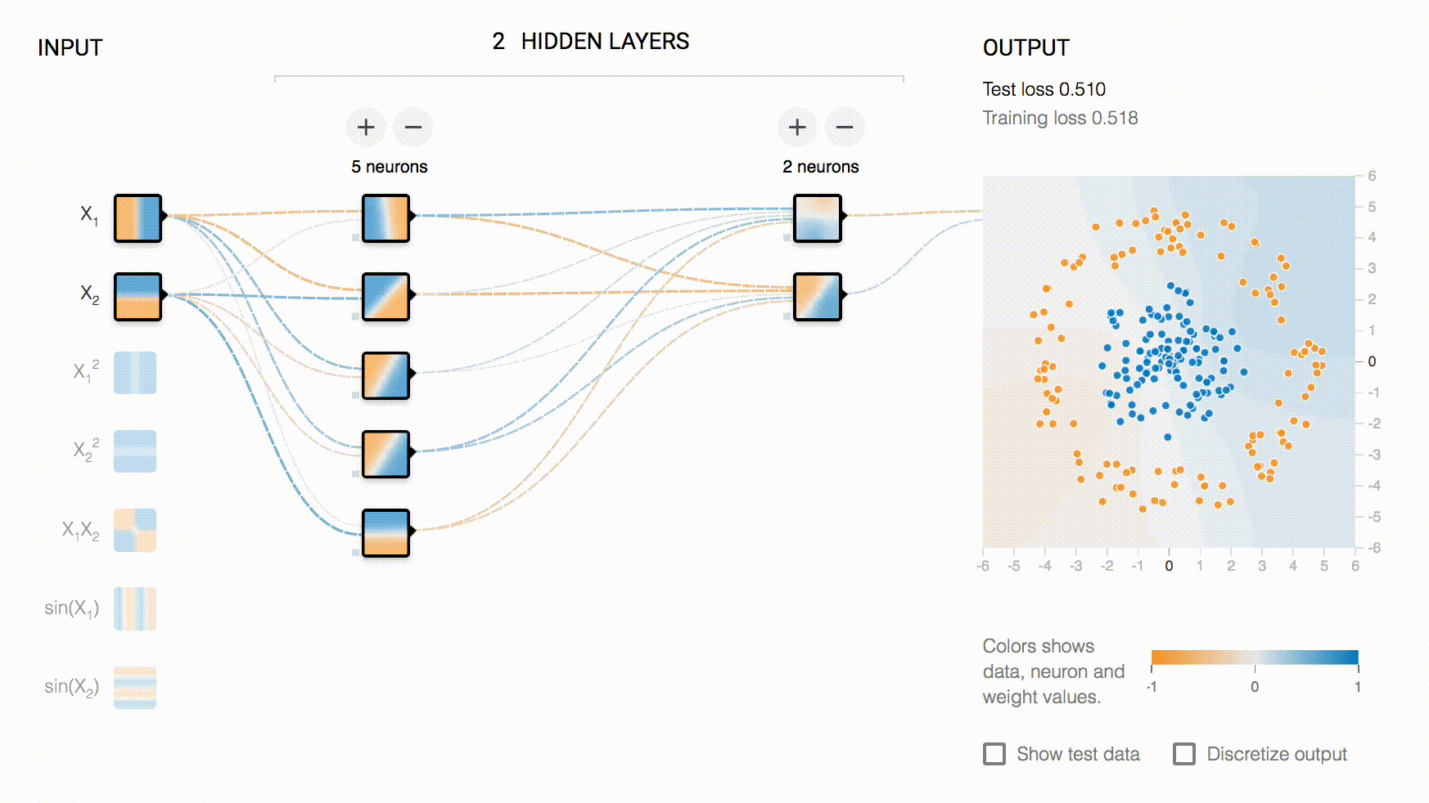
Why Gradient Descent
Cite: Oleh Nicholas, Feb 12th, 2019.

Slide 19
Why Gradient Descent
Gradient descent aims to perform on the loss function, which intends to minimize the error values, and therefore maximize the prediction accuracy.
Felix Kling, 2020

Slide 20
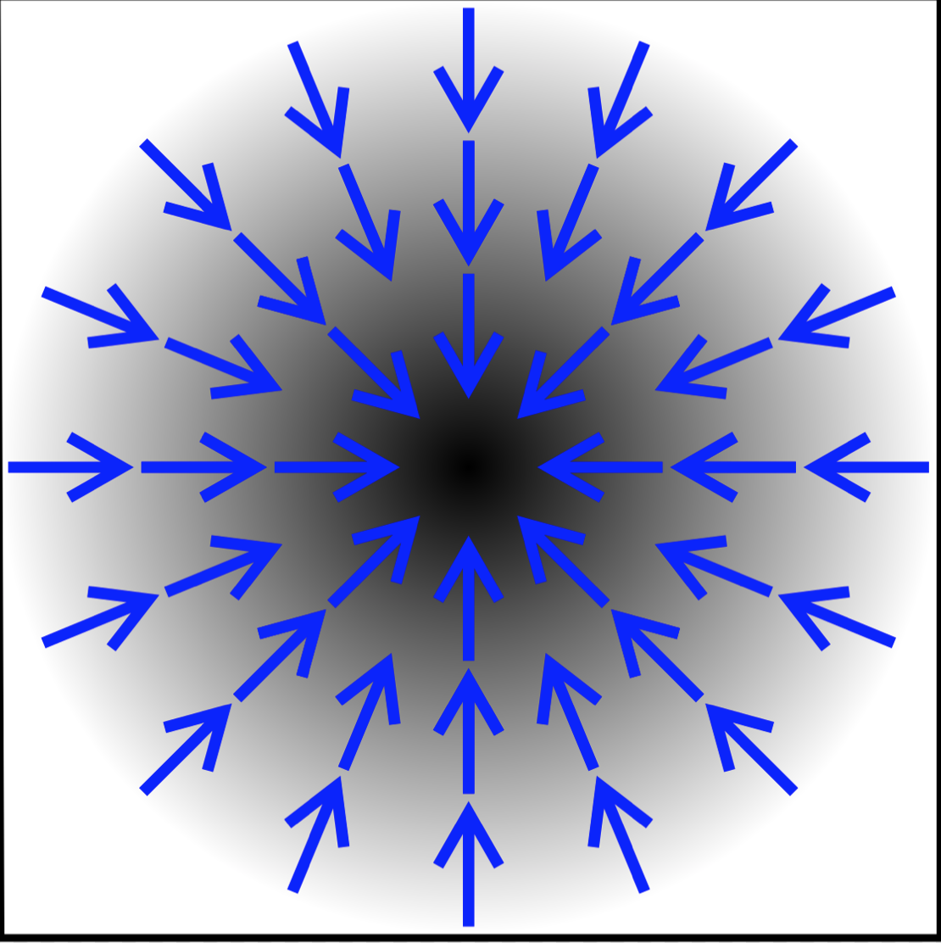
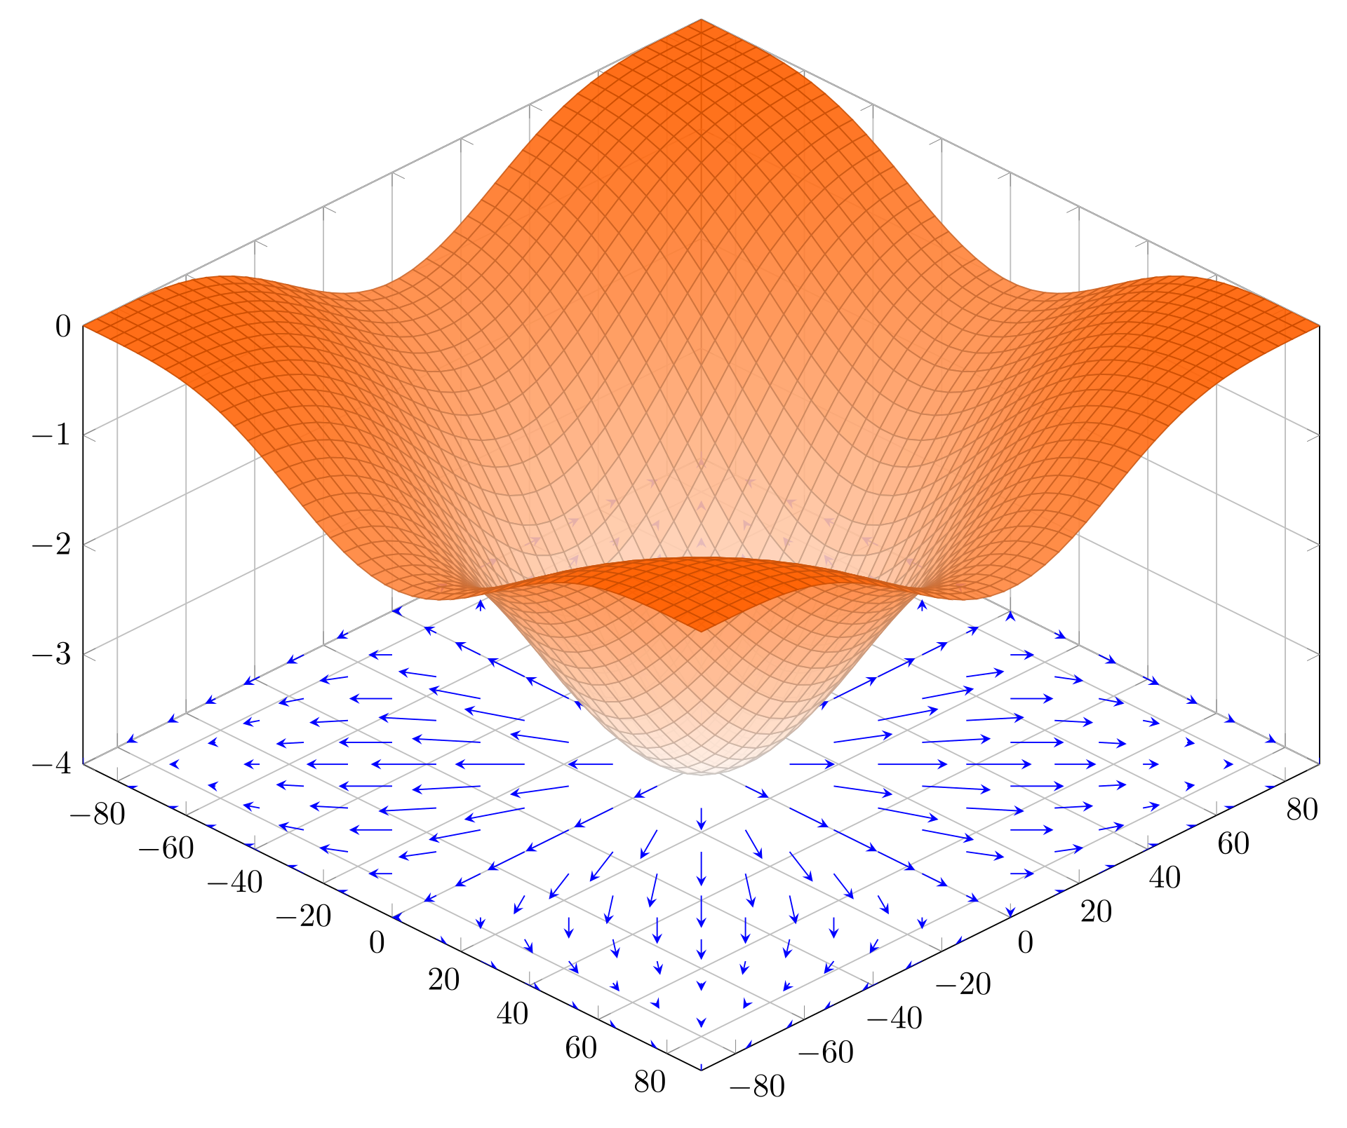
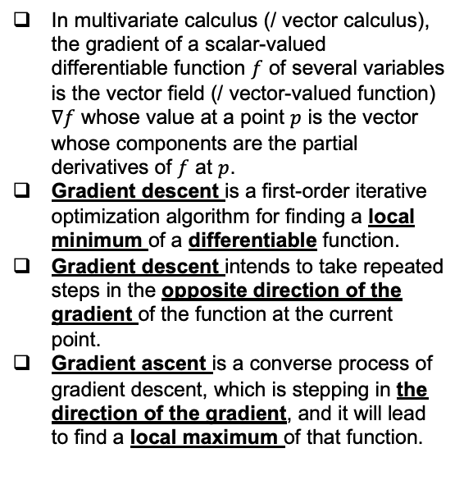
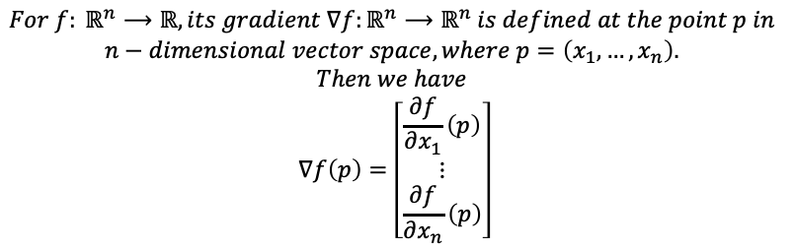
Gradient & Gradient Descent
In multivariate calculus (/ vector calculus), the gradient of a scalar-valued differentiable function $f$ of several variables is the vector field (/ vector-valued function) $∇f$ whose value at a point $p$ is the vector whose components are the partial derivatives of $f$ at $p$.
Gradient descent is a first-order iterative optimization algorithm for finding a local minimum of a differentiable function.
Gradient descent intends to take repeated steps in the opposite direction of the gradient of the function at the current point.
Gradient ascent is a converse process of gradient descent, which is stepping in the direction of the gradient, and it will lead to find a local maximum of that function.
$$For f: ℝ^{n}⟶ℝ, its gradient ∇f:ℝ^{n}⟶ℝ^{n} is defined at the point p in$$
$$n−dimensional vector space, where p=\left(x_{1},…,x_{n}\right).$$
$$Then we have$$
$$∇f\left(p\right)=\left[\begin{matrix}\frac{∂f}{∂x_{1}}\left(p\right) \\ ⋮ \\ \frac{∂f}{∂x_{n}}\left(p\right)\end{matrix}\right]$$
Cite: Wikipedia.

Slide 21
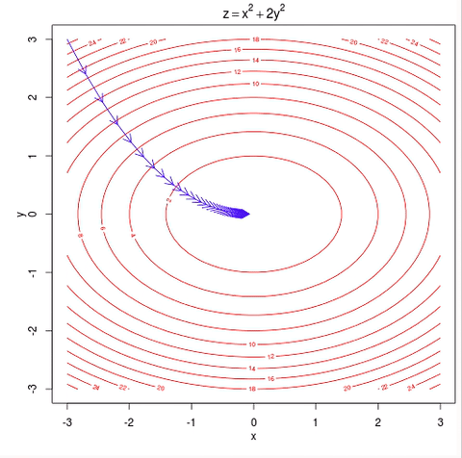

Gradient Descent Algorithm
Cite: Hoang Duong and Ayoosh Kathuria

Slide 22
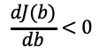
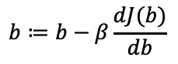
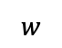
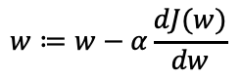
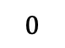
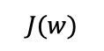
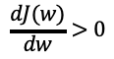
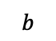
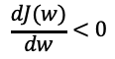
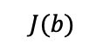
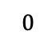
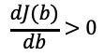
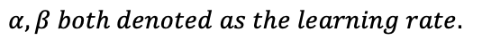
Gradient Descent
$$J(w)$$
$$J(b)$$
$$\frac{dJ(b)}{db}>0$$
$$\frac{dJ(w)}{dw}>0$$
$$\frac{dJ(w)}{dw}<0$$
$$\frac{dJ(b)}{db}<0$$
$$0$$
$$0$$
$$w$$
$$b$$
$$w≔w−α\frac{dJ(w)}{dw}$$
$$b≔b−β\frac{dJ(b)}{db}$$
$$α,β both denoted as the learning rate.$$

Slide 23
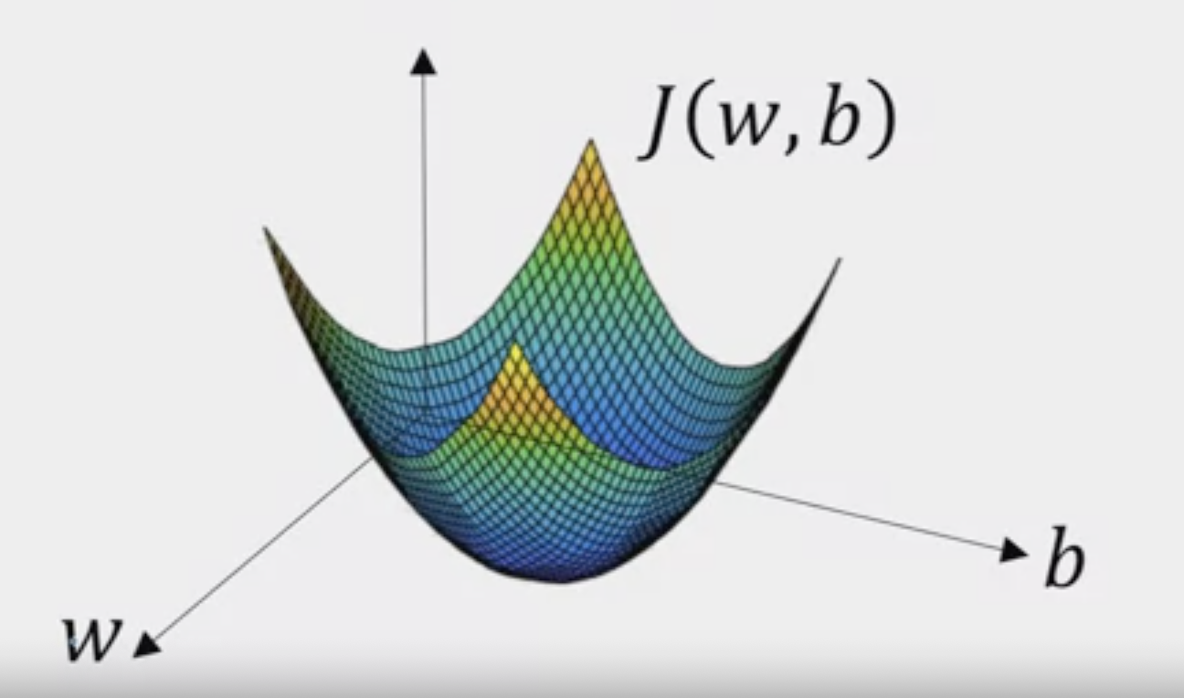


Gradient Descent
$$Cost Function:$$
$$J\left(w, b\right)=\frac{1}{m}\sum_{i=1}^{m}{ℒ\left({\hat{y}}^{\left(i\right)},y^{\left(i\right)}\right)=−\frac{1}{m}\sum_{i=1}^{m}{\left[y^{\left(i\right)}\log_{10}\left({\hat{y}}^{\left(i\right)}\right)+\left(1−y^{\left(i\right)}\right)\log_{10}\left(1−{\hat{y}}^{\left(i\right)}\right)\right]}}$$
$$Objective of Gradient Descent:$$
$$Find the appropriate$$
$$values of w and b to minimize the value of J(w,b)$$
$$w≔w−α\frac{∂J\left(w,b\right)}{∂w}, b≔b−α\frac{∂J\left(w,b\right)}{∂b}, where α denoted as the learning rate$$

Slide 24





Convolution in Mathematics
Properties of convolution:
$$f ∗g=g ∗f$$
$$f ∗\left(g ∗h\right)=\left(f ∗g\right) ∗h$$
$$f\left(x\right) ∗g\left(x\right)= \int_{0}^{x}{f\left(τ\right)g\left(x−τ\right)dτ}$$
$$f ∗ \left(g+h\right)=\left(f∗g\right)+\left(f∗h\right)$$
$$Proof:$$
$$Let u=x−τ, then$$
$$f\left(x\right)∗g\left(x\right)=\int_{0}^{x}{f\left(τ\right)g\left(x−τ\right)dτ}$$
$$=−\int_{x}^{0}{f\left(x−u\right)g\left(u\right)du}=\int_{0}^{x}{f\left(x−u\right)g\left(u\right)du}$$
$$=\int_{0}^{x}{g\left(u\right)f\left(x−u\right)du}=g\left(x\right)∗f(x)$$
In-Class Practice: Prove the first community property

Slide 25




Convolutional Neural Network (CNN) in Computer Vision (CV)

Slide 26

CNN and edge Detection
Cite: Piotr Skalski, April 12th, 2019.

Slide 27



Basics of Convolution in Computer Vision
Sliding Window
Stride
Padding
Cite: Kaggle

Slide 28



Kernel Convolutional
Input Image
10 | 10 | 10 | 10 | 10 | 10
10 | 10 | 10 | 10 | 10 | 10
10 | 10 | 10 | 10 | 10 | 10
0 | 0 | 0 | 0 | 0 | 0
0 | 0 | 0 | 0 | 0 | 0
0 | 0 | 0 | 0 | 0 | 0
Kernel
Feature Map
1 | 2 | 1
0 | 0 | 0
-1 | -2 | -1
0 | 0 | 0 | 0
40 | 40 | 40 | 40
40 | 40 | 40 | 40
0 | 0 | 0 | 0
Question:
Guess the shape of the feature map
Compute the feature map
$$∗$$
$$=$$
$$G\left[m,n\right]=\left(f∗h\right)\left[m,n\right]=\sum_{j}{\sum_{k}{h\left[j,k\right]f[m−j,n−k]}}$$
Notes:
Stride – value be 1 at this case, move 1 pixel each time
Padding – no padding this case, called valid case

Slide 29

Kernel Convolution
Cite: Piotr Skalski, April 12th, 2019.

Slide 30



Why Padding in Convolution

Slide 31


CNN in 3-Channel RGB Images
Cite: Sumit Saha, Dec 15th, 2018.

Slide 32


Pooling in CNN
Reduce the Usage and Cost of the Computational Power
Recognize the Domain Features
Cite: Lukas Biewald, and Wu Jun

Slide 33


Pooling in CNN
Cite: Sumit Saha, and Rob Robinson

Slide 34

Back-Propagation of CNN
Cite: Piotr Skalski, April 12th, 2019.

Slide 35

HW Review
1
2
3
4
Crop function is a python built in python to crop images
We consider the upper right corner as the starting point of the image and its coordinate be (0,0)
original image size be (2048, 1536)
Image patch size be (512,512)
Number of image patches without overlapping = (2048 * 1536) / (512 * 512) = 12
5
6
7
8
9
10
11
12

Slide 36
Q & A

